Slide 1

MALIGNANT COMMENTS CLASSIFICATION
The proliferation of social media enables people to express their opinions widely online. However, at the same time, this has resulted in the emergence of conflict and hate, making online environments uninviting for users. Although researchers have found that hate is a problem across multiple platforms, there is a lack of models for online hate detection.
Online hate, described as abusive language, aggression, cyberbullying, hatefulness and many others has been identified as a major threat on online social media platforms. Social media platforms are the most prominent grounds for such toxic behaviour.
There has been a remarkable increase in the cases of cyberbullying and trolls on various social media platforms. Many celebrities and influences are facing backlashes from people and have to come across hateful and offensive comments. This can take a toll on anyone and affect them mentally leading to depression, mental illness, self-hatred and suicidal thoughts.
Internet comments are bastions of hatred and vitriol. While online anonymity has provided a new outlet for aggression and hate speech, machine learning can be used to fight it. The problem we sought to solve was the tagging of internet comments that are aggressive towards other users. This means that insults to third parties such as celebrities will be tagged as unoffensive, but “u are an idiot” is clearly offensive.
Our goal is to build a prototype of online hate and abuse comment classifier which can used to classify hate and offensive comments so that it can be controlled and restricted from spreading hatred and cyberbullying.

Slide 2
Data Set Description
The data set contains the training set, which has approximately 1,59,000 samples and the test set which contains nearly 1,53,000 samples. All the data samples contain 8 fields which includes ‘Id’, ‘Comments’, ‘Malignant’, ‘Highly malignant’, ‘Rude’, ‘Threat’, ‘Abuse’ and ‘Loathe’.
The label can be either 0 or 1, where 0 denotes a NO while 1 denotes a YES. There are various comments which have multiple labels. The first attribute is a unique ID associated with each comment.
The data set includes:
Malignant: It is the Label column, which includes values 0 and 1, denoting if the comment is malignant or not.
Highly Malignant: It denotes comments that are highly malignant and hurtful.
Rude: It denotes comments that are very rude and offensive.
Threat: It contains indication of the comments that are giving any threat to someone.
Abuse: It is for comments that are abusive in nature.
Loathe: It describes the comments which are hateful and loathing in nature.
ID: It includes unique Ids associated with each comment text given.
Comment text: This column contains the comments extracted from various social media platforms.
This project is more about exploration, feature engineering and classification that can be done on this data. Since the data set is huge and includes many categories of comments, we can do good amount of data exploration and derive some interesting features using the comments text column available.

Slide 3
Model Building Phase
After collecting the data, you need to build a machine learning model. Before model building do all data pre-processing steps. Try different models with different hyper parameters and select the best model.
Follow the complete life cycle of data science. Include all the steps like
1. Data Cleaning
2. Exploratory Data Analysis
3. Data Pre-processing
4. Model Building
5. Model Evaluation
6. Selecting the best model

Slide 4
EDA
Shape of the dataset.
Information of the dataset.
Data cleaning.

Slide 5
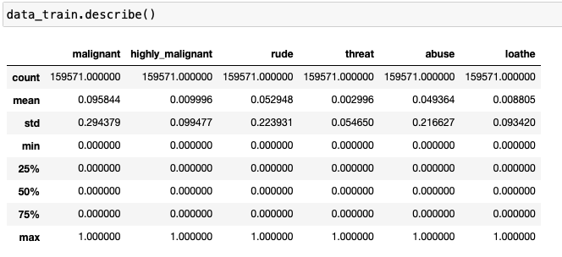
Descriptive Statistic:

Slide 6
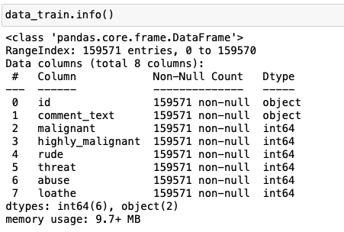
Information of dataset:-

Slide 7
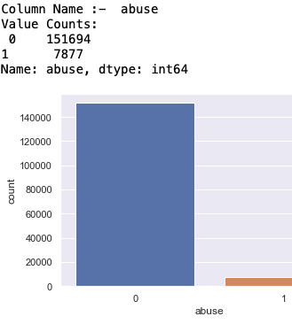
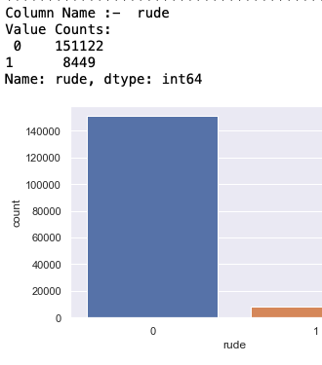
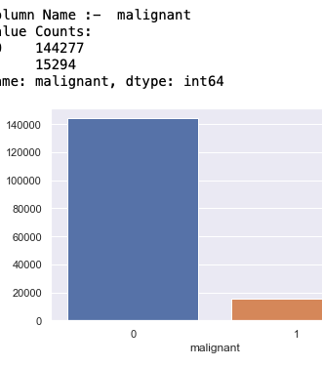
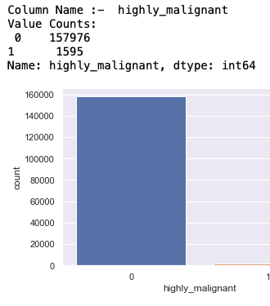
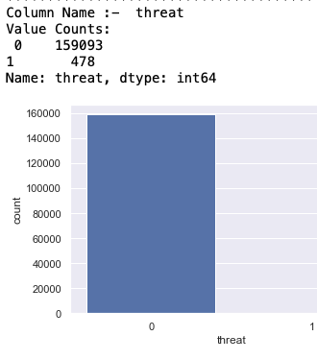

Visualization

Slide 8
Natural Language Processing (NLP)
Data Preprocessing
wordnet
Converting to lower case
Stopwords
Punkt
Removing the URL's
Removing the numbers
Dealing with Punctuation
Removing Stop word
Applying Lemmatization

Slide 9
Length before and after preprocessing
Original Length : 62893130
Clean Length : 42481209

Slide 10
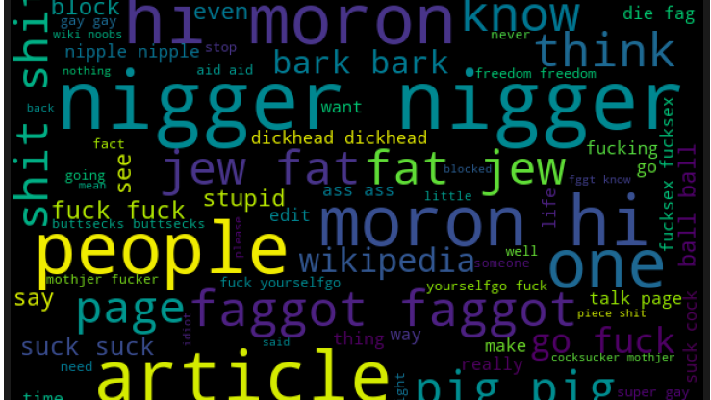
Word Cloud

Slide 11
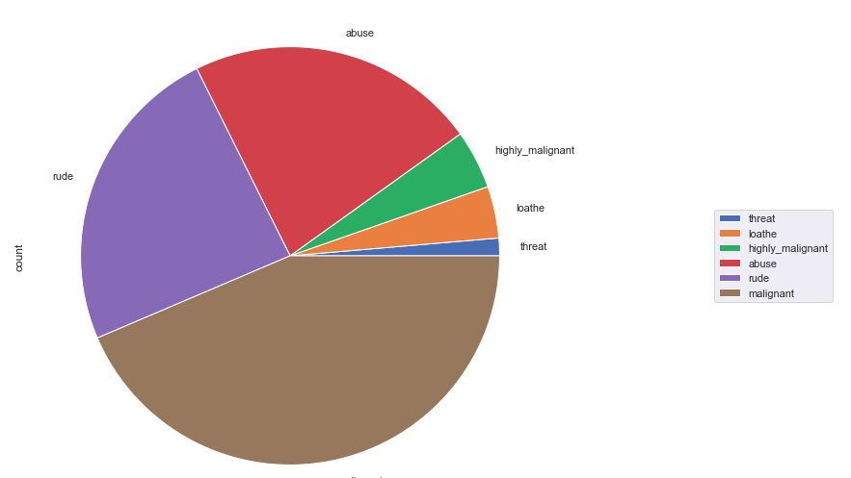
Pie-Chart

Slide 12
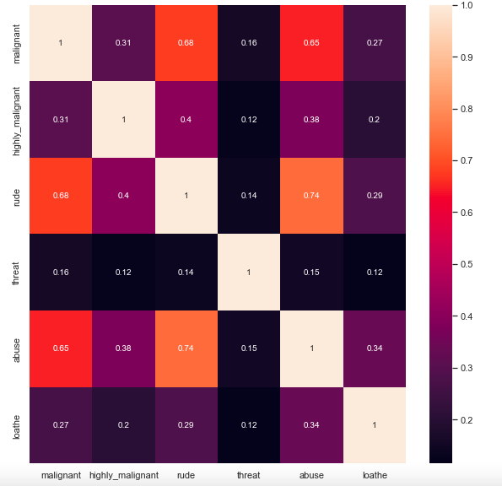
Correlation
No Multicollinearity problem present.

Slide 13
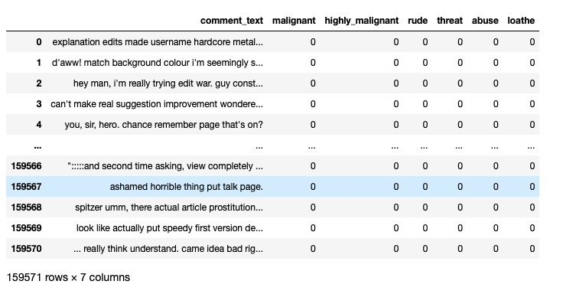
Final Dataset

Slide 14
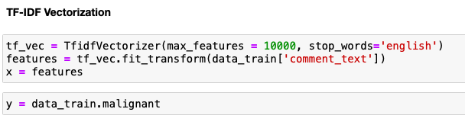
Encoding TF-IDF Vectorizer

Slide 15
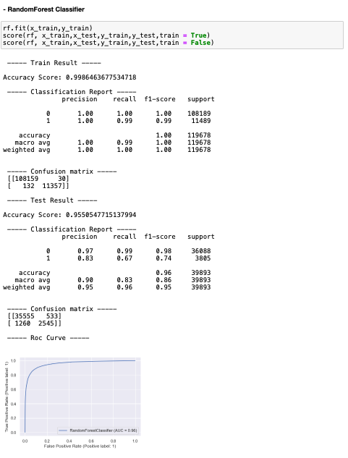
Best Model, Parameters & Score:
RandomForest Classifier.

Slide 16
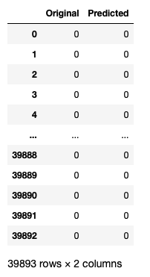
Original VS Predicted
- RandomForest Classifier.

Slide 17
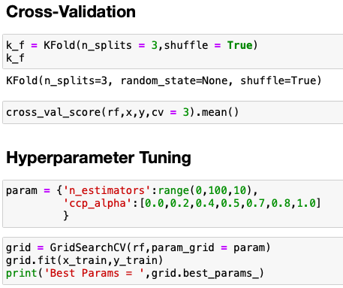
Hyperparameter Tuning & Cross-Validation

